Slide 1

Discovery of Biosynthetic Clusters in Genomes and Metagenomes using IMG-ABC Data and Software
Natalia Ivanova
Sept 27, 2016
Notes:
My name is Michalis Hadjithomas and I am a computational biologist in the Functional annotation group.

Slide 2
Outline
Introduction
IMG-ABC
User Interface
Case Study – Pseudomonas fluorescens
Use Cases
Notes:
Since many of you might not be familiar with secondary metabolism, I will give you a short overview of the field and why are involved in it.
I will briefly talk to you about how we got the data and then give you a tour of the user interface.
Lastly we will go through a few use cases, before diving in the exercises.

Slide 3
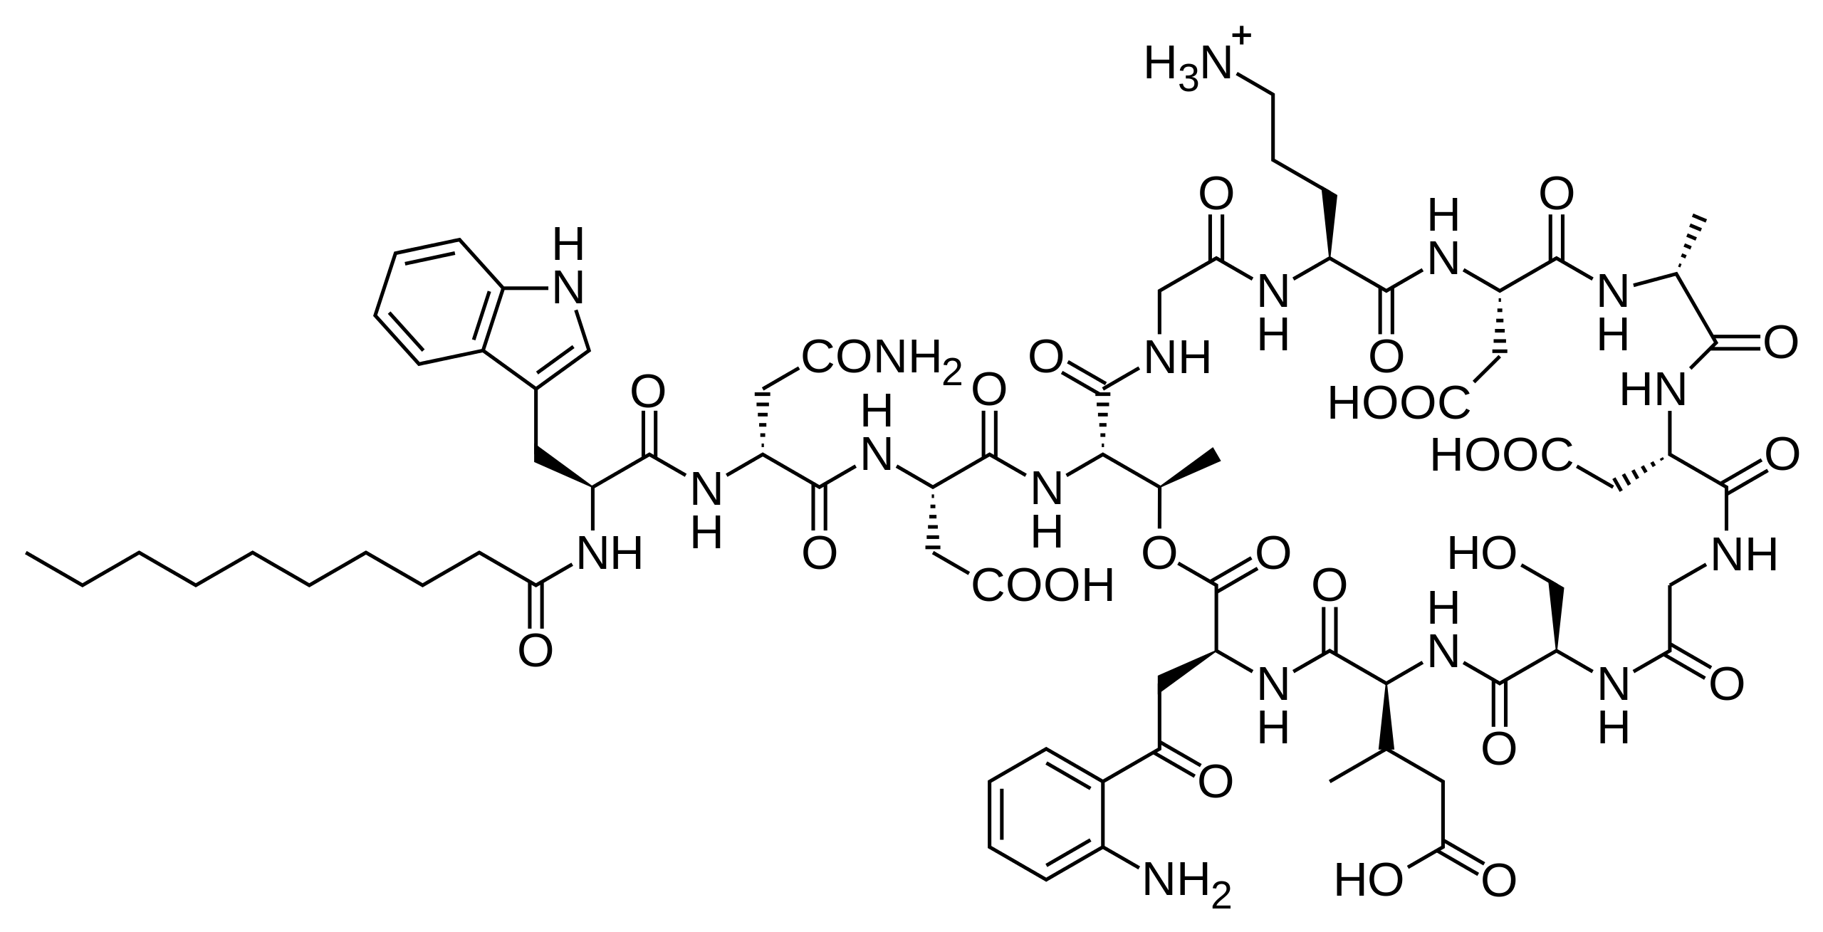
Introduction
Secondary metabolites are organic molecules that are not essential for the growth of the producing organism
Communication
Quorum Sensing (Homoserine lactones)
Warfare
Anti-bacterial agents (Daptomycin)
Survival
Extracellular electron transfer (phenazines)
Organisms invest a lot of resources in SM
Streptomyces roseosporus
Notes:
Microbial-microbial interactions, host-pathogen/sumbiont
Another observation that denotes the importance of these secondary metabolites is that organisms invest a huge amount of energy in maintain the genes that produce them.
S. roseosporous e.g. invests 2% of its genome to the production of a single SM.

Slide 4
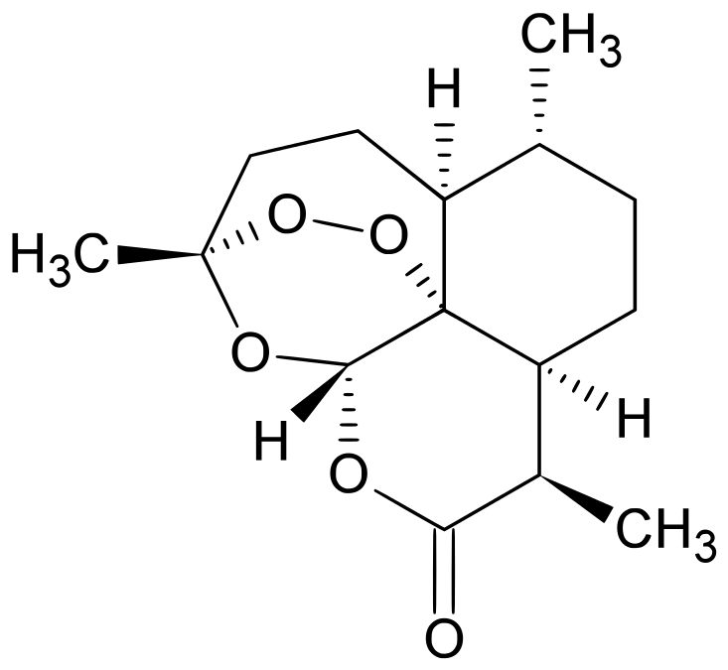
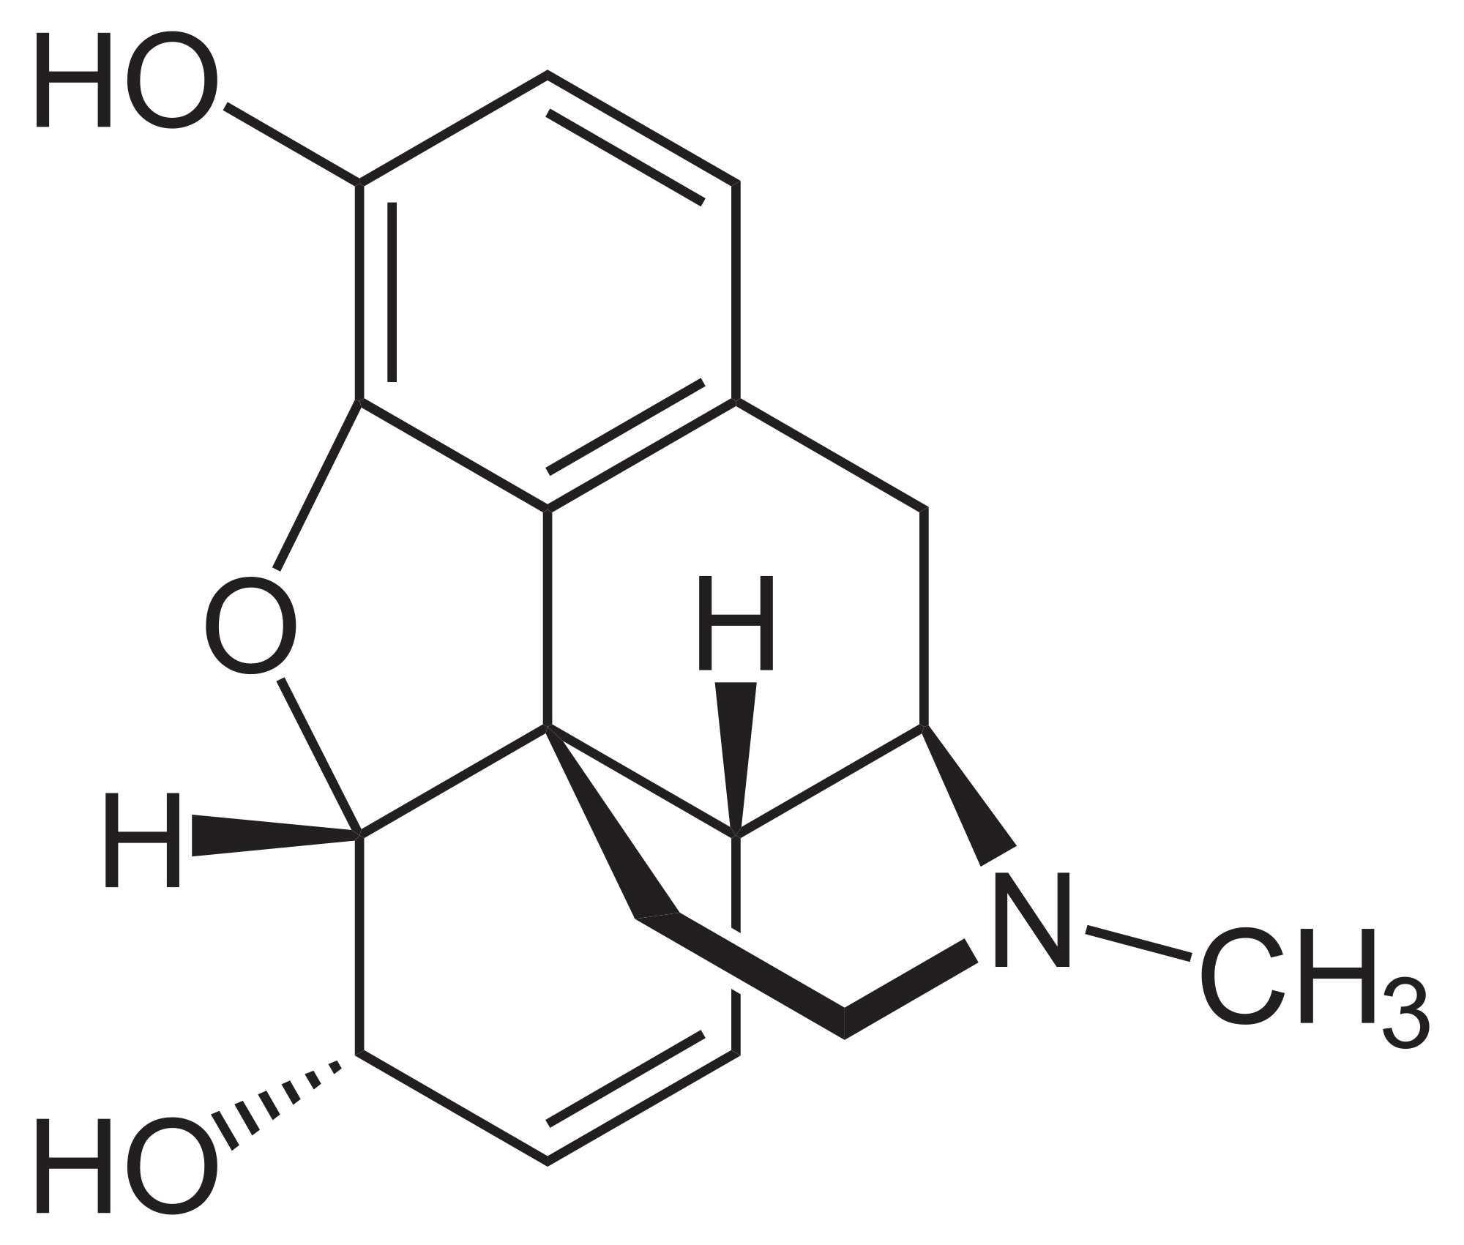
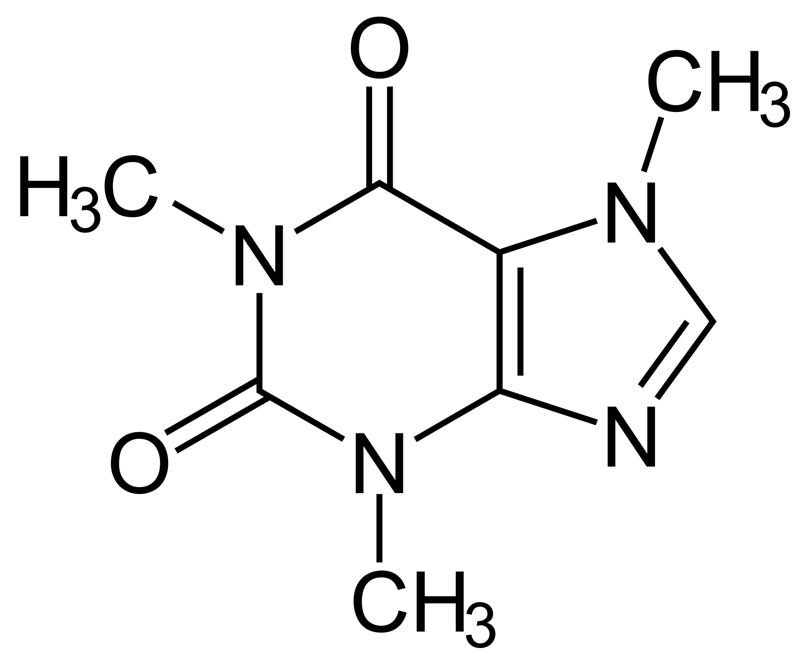
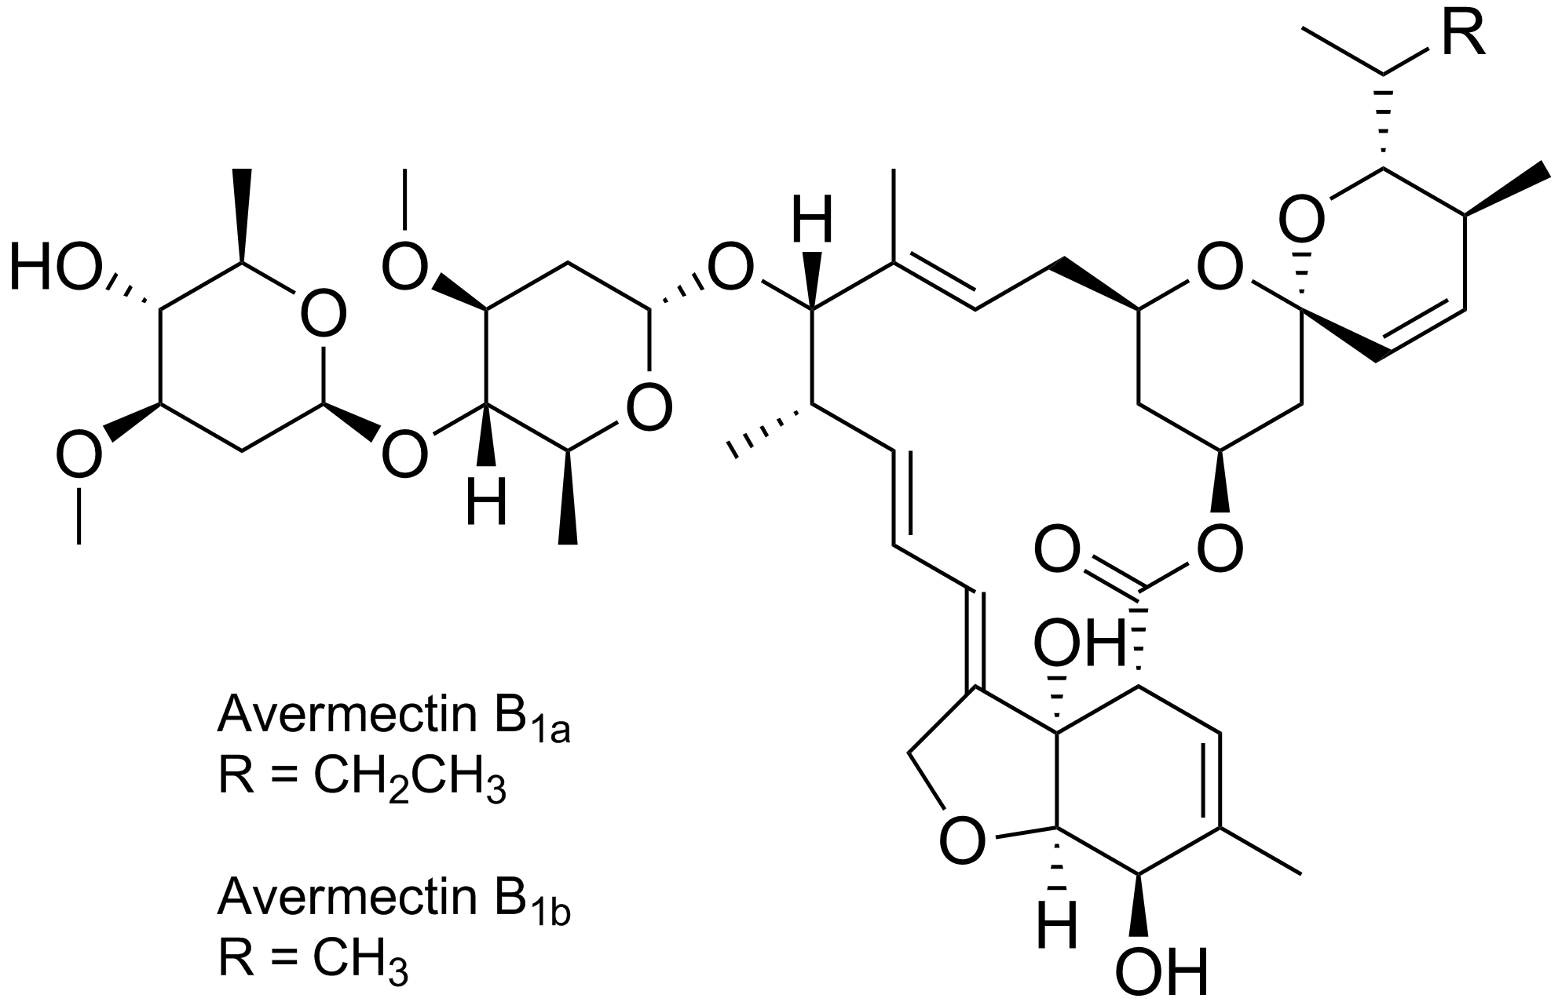
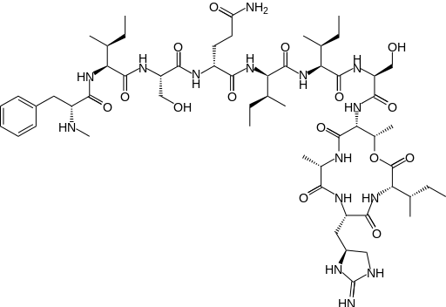
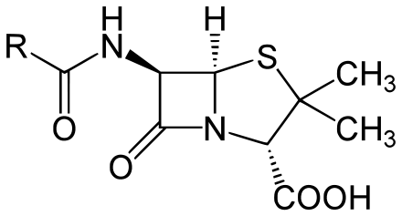
Introduction
Secondary metabolites are organic molecules that are not necessary for the growth of the producing organism
Communication
Quorum Sensing (Homoserine lactones)
Warfare
Anti-bacterial agents (Daptomycin)
Survival
Extracellular electron transfer (phenazines)
Plant derived
Artemisinin
Morphine
Caffeine
Microbe derived
Penicillin
Avermectin
Teixobactin
Notes:
A lot of these functions can be hijacked by humans to serve technological/therapeutic purposes. Artemisinin : anti malarial,
Avermectin: anti parasite (streptomyces)

Slide 5
Traditional SM discovery approach
Isolate organism in pure culture
Grow
Search for SMs (chemical or biochemical assays, MS)
Limitations:
99% of organisms in an environmental sample are unculturable
Undetectable SM
Cryptic SM potential

Slide 6
SMs encoded by genes in clusters
SMs are often encoded by genes that are found in clusters
Computational prediction of biosynthetic clusters allows discovery of SMs:
- that are cryptic
- in the rare biosphere, i.e. the 99% of organisms in an env. sample
Notes:
Going back to Daptomycin, you might have noticed that the genes are found together in a cluster. This is the case for many SMs.
This observation forms the basis on which computational methods have been developed to predict biosynthetic gene clusters.

Slide 7
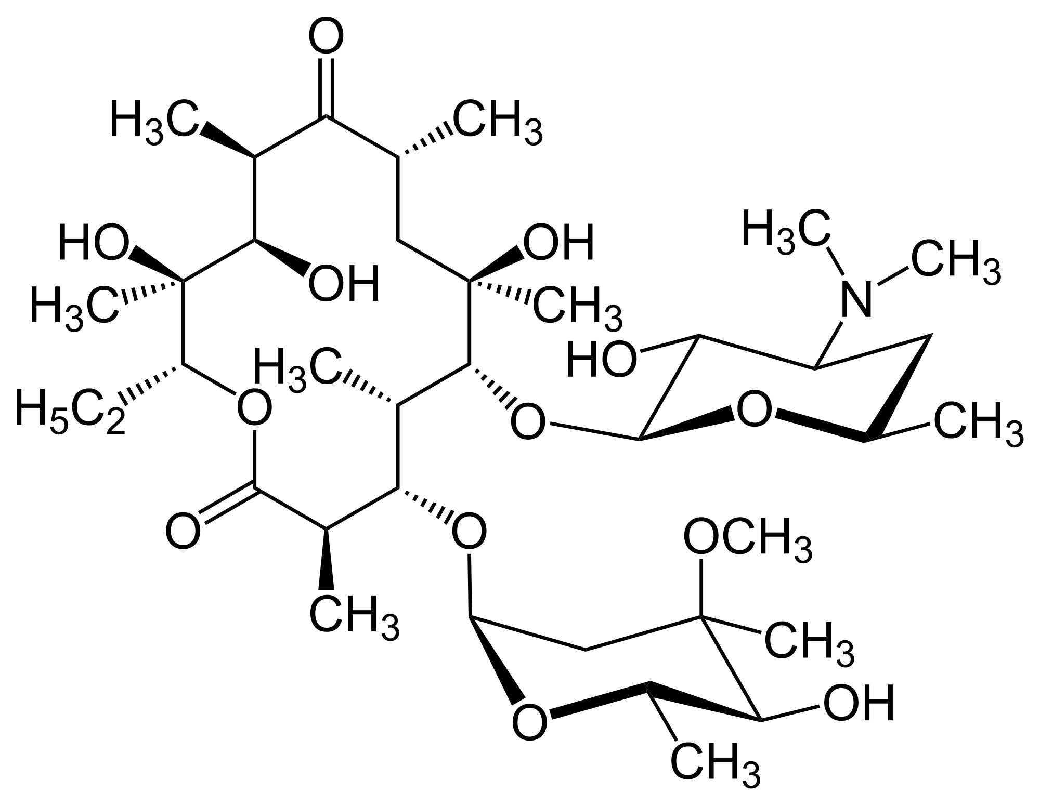
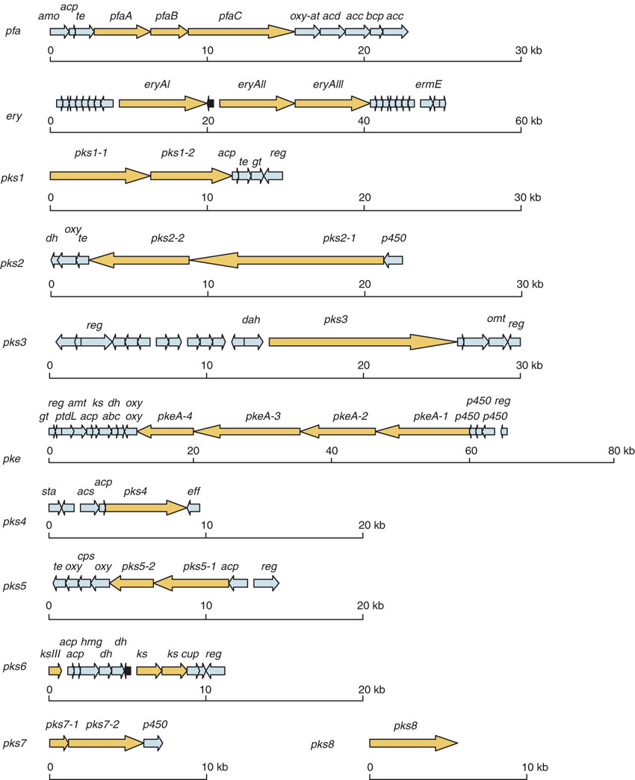
Cryptic Biosynthetic Clusters
Saccharopolyspora erythraea:
8.2 Mbp Actinomycete
commercial producer of erythromycin A
erythromycin A
Oliynyk, Markiyan, et al. "Complete genome sequence of the erythromycin-producing bacterium Saccharopolyspora erythraea NRRL23338." Nature biotechnology 25.4 (2007): 447-453.
Notes:
S. erythraea produces erythromycin A, an important broad-spectrum antibiotic against pathogenic Gram-positive bacteria. Erythromycin was discovered in 1949, biosynthetic cluster sequenced in 1991.
Saccharopolyspora erythraea is used for the industrial-scale production of the antibiotic erythromycin A, derivatives of which play a vital role in medicine.
The sequenced chromosome of this soil bacterium comprises 8,212,805 base pairs, predicted to encode 7,264 genes.

Slide 8
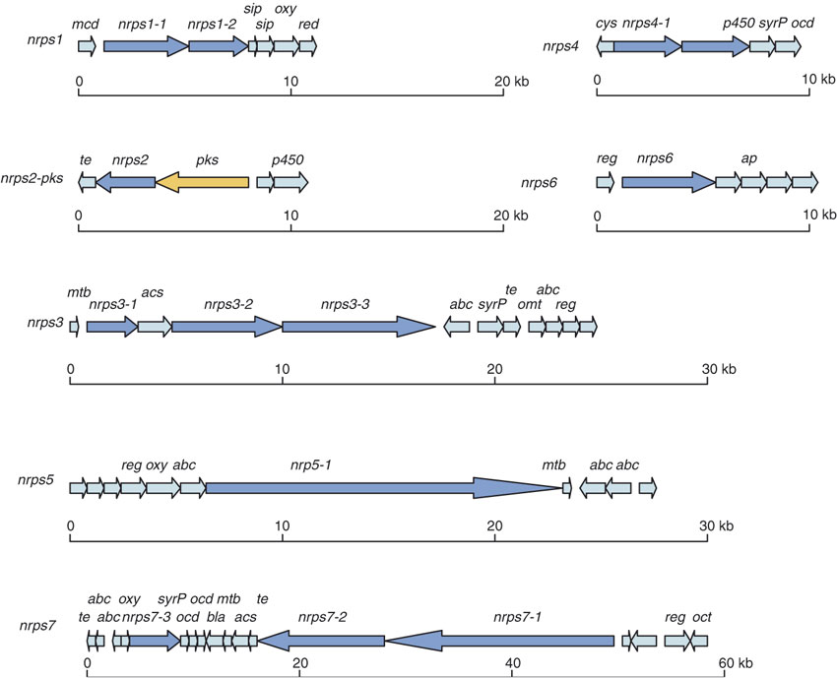
Cryptic Biosynthetic Clusters
Saccharopolyspora erythraea:
8.2 Mbp Actinomycete
commercial producer of erythromycin A
erythromycin A
At least 17 cryptic BCs
Oliynyk, Markiyan, et al. "Complete genome sequence of the erythromycin-producing bacterium Saccharopolyspora erythraea NRRL23338." Nature biotechnology 25.4 (2007): 447-453.
Notes:
S. erythraea produces erythromycin A, an important broad-spectrum antibiotic against pathogenic Gram-positive bacteria
Saccharopolyspora erythraea is used for the industrial-scale production of the antibiotic erythromycin A, derivatives of which play a vital role in medicine.
The sequenced chromosome of this soil bacterium comprises 8,212,805 base pairs, predicted to encode 7,264 genes.

Slide 9
SMs encoded by genes in clusters
SMs are often encoded by genes that are found in clusters
Computational prediction of biosynthetic clusters allows discovery of SMs:
- that are cryptic
- in the rare biosphere, i.e. the 99% of organisms in an env. sample
New paradigm for SM discovery:
Sequence
Computational prediction
DNA Synthesis
Expression/ Isolation
Functional Characterization
$$$
Notes:
Going back to Daptomycin, you might have noticed that the genes are found together in a cluster. This is the case for many SMs.
This observation forms the basis on which computational methods have been developed to predict biosynthetic gene clusters.

Slide 10




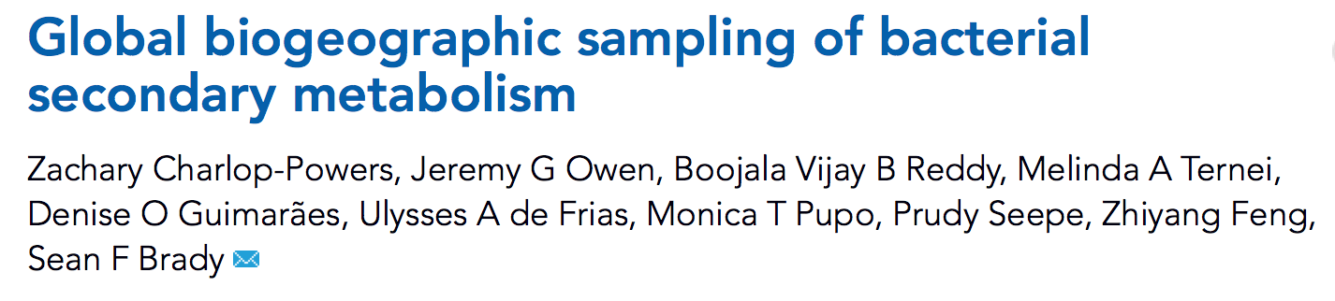

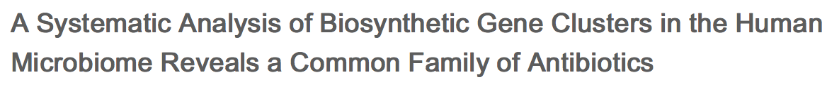

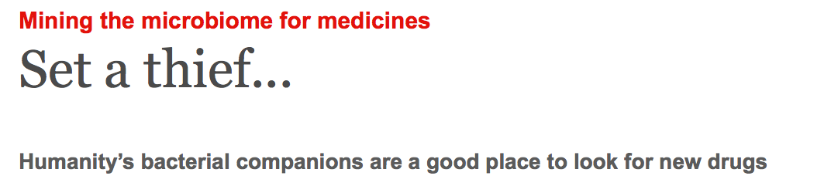
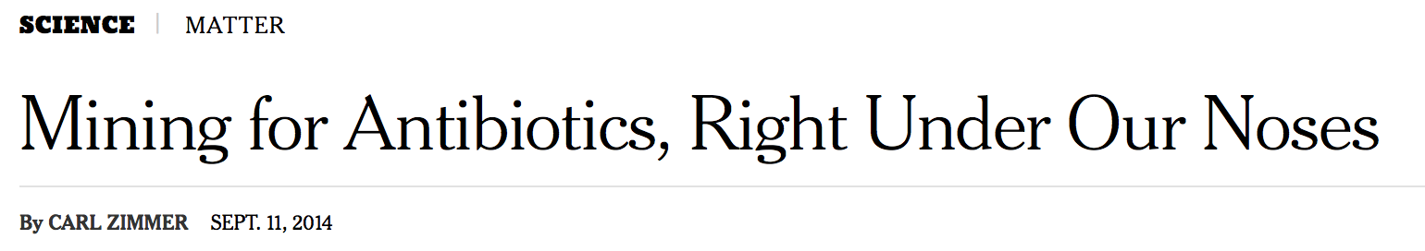

Resurgence
Notes:
The development of these techniques has led to a resurgence of interest in secondary metabolism: Two examples
Sean Brady at rockefeller is lloking for SMs in environmental samples across the world
M Fischbacj at UCSF took the reverse approach and look for SMs within us.

Slide 11
IMG-ABC
Atlas of Biosynthetic gene Clusters
Predicted biosynthetic gene clusters (BC) and secondary metabolites (SM) associated with experimental BCs.
Hadjithomas, Michalis, et al. "IMG-ABC: A knowledge base to fuel discovery of biosynthetic gene clusters and novel secondary metabolites." mBio 6.4 (2015): e00932-15.
Notes:
That’s where we come in. We have in IMG >40,000 datasets, isolates and metagenomes.
Uniquely able to look at Smetabolism at a global scale, and provie the bioinformatic capability to you, our users, to perform their own analyses.

Slide 12
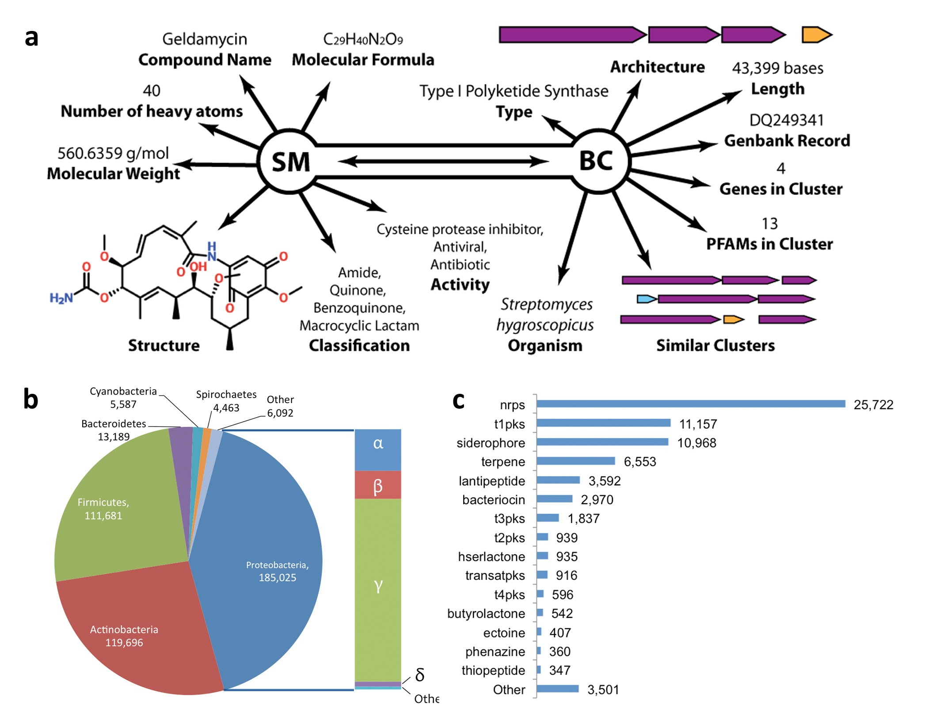
IMG-ABC: Data Acquisition
Predicted
Experimentally Verified
Search Genbank for BC related records
Assign SM name to that record
Manually curate predictions
Query PubChem Compound with SM name
Retrieve physical/functional descriptors associated with SM
Import into IMG
Run AntiSMASH v2
Retain BC type, coordinates, probability
Filter out false positives
Notes:
There are two sides to ABC, SM and BCs.

Slide 13
AntiSMASH v2 algorithm
Two modes of prediction:
Rule based
Detects combinations of specific PFAMs and custom HMMs
Expands region by certain nucleotide length
Version 2 annotates ~20 BC types
ClusterFinder
Probabilistic algorithm based on a training set of 732 BCs
Each pfam domain assigned a probability of being part of a BC
Predicts known and unknown BCs
Blin, Kai, et al. "antiSMASH 2.0—a versatile platform for genome mining of secondary metabolite producers." Nucleic acids research (2013): gkt449.

Slide 14
Caveat emptor
IMG-ABC is an actively developed resource
AntiSMASH is an actively developed resource (v 3.0 available)
Experimental BCs may include flanking non-BC sequences, or may not include all BC genes (i.e. partial BCs)
Experimental BCs may contain incorrect information about SM (or no information at all)
Boundaries of BCs are difficult to predict
False positive predictions
False negative non-predictions

Slide 15
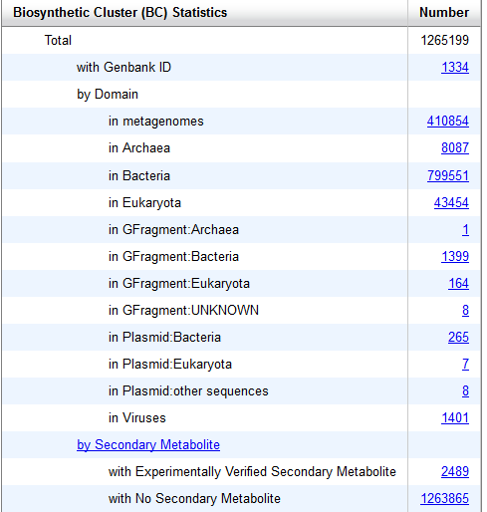
Content Summary (# BCs)

Slide 16
Latest features added to IMG-ABC
BC Cart
Ability to perform analyses on groups of BCs
BC Set in Workspace
Save findings for easy recall
Pairwise Similarity calculations for BCs
Visualize the similarities between BCs in BC Cart
Download data for Cytoscape
Discovery of conserved BCs (families)
Comparison of SM potential of genomes
Heatmap Matrix
Discovery of conserved functions between BCs within the same BC class
Download data for Gene-e visualization

Slide 17
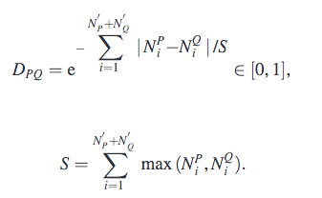
BC Similarity Calculation
Jaccard Similarity Index
BC1
BC2
(5)
Score =
= 0.71
(7)
Adjusted Score = 0.36 *Jaccard Index + 0.64 * domain duplication index
Lin, Kui, Lei Zhu, and Da-Yong Zhang. "An initial strategy for comparing proteins at the domain architecture level." Bioinformatics 22.17 (2006): 2081-2086.
Cimermancic, Peter, et al. "Insights into secondary metabolism from a global analysis of prokaryotic biosynthetic gene clusters." Cell 158.2 (2014): 412-421.

Slide 18
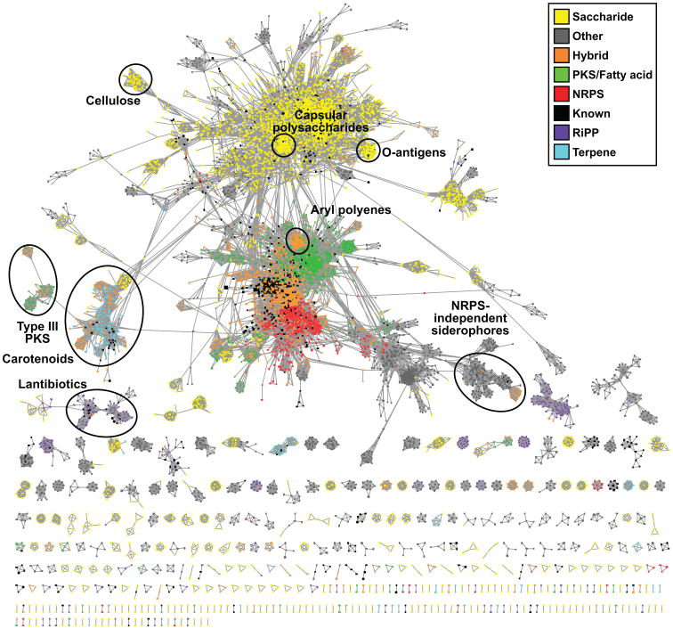
BC Similarity Calculation
Cimermancic, Peter, et al. "Insights into secondary metabolism from a global analysis of prokaryotic biosynthetic gene clusters." Cell 158.2 (2014): 412-421.

Slide 19
User Interface
Live Demo

Slide 20
Case Study – Pseudomonas fluorescens
Let’s Assume we have finished genomes of 14 strains of Pseudomonas fluorescens and we want to study their secondary metabolism.

Slide 21
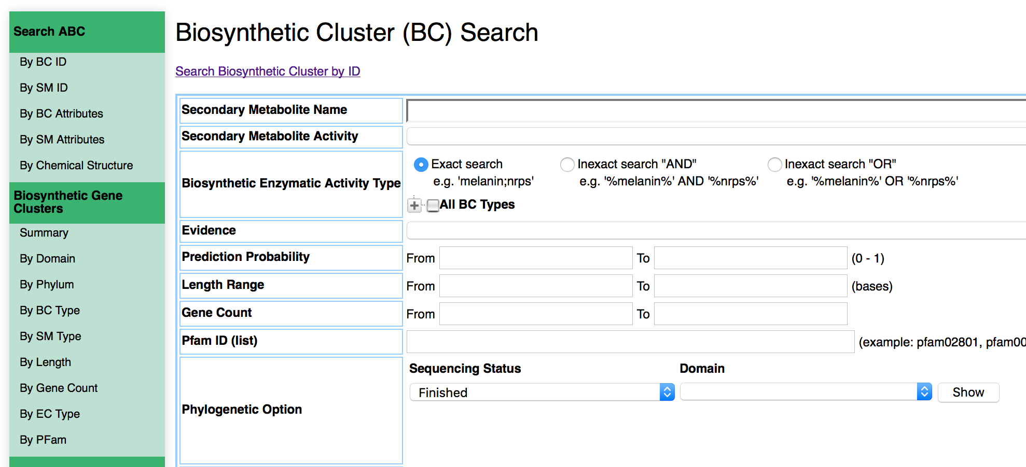
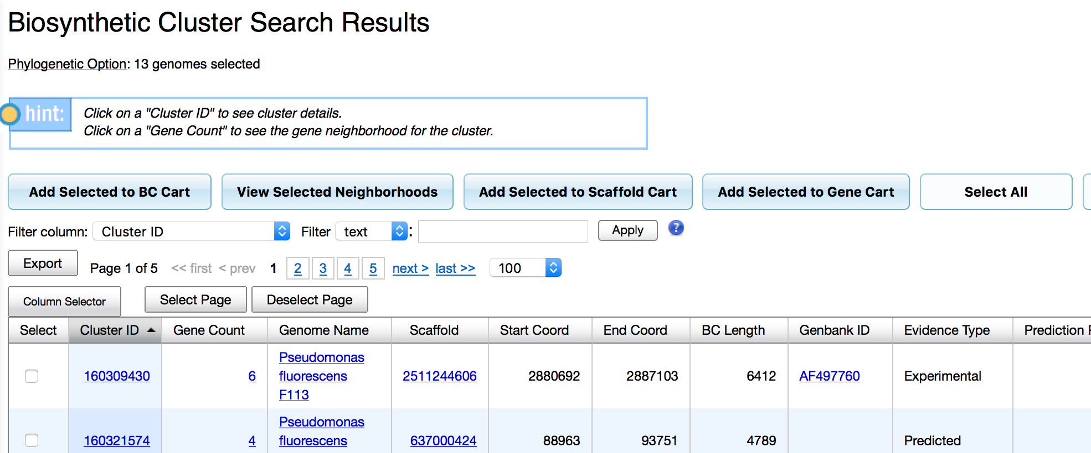
Case Study: Finding all BCs in your set of genomes
Search for all BCs in finished Pseudomonas fluorescens genomes.
Add them to the BC Cart

Slide 22
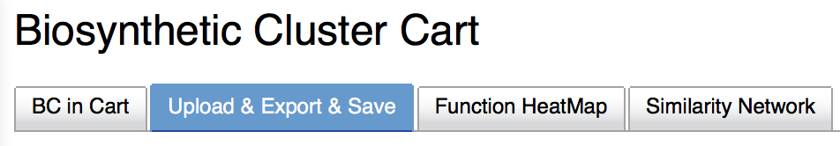
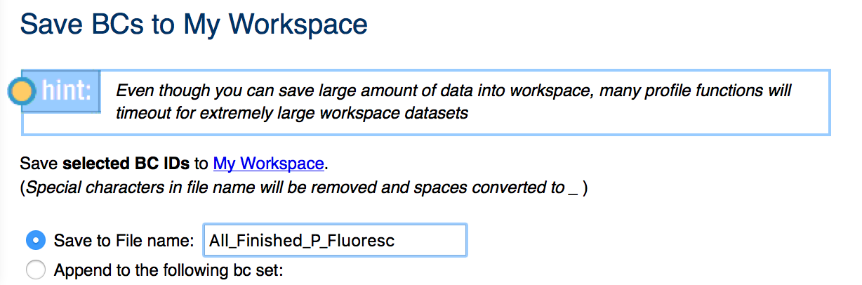
Case Study: Saving the results
A good practice is to always save findings to the Workspace:
prevents loss of data because of inactivity timeout
saves time to no have to repeat lengthy queries

Slide 23
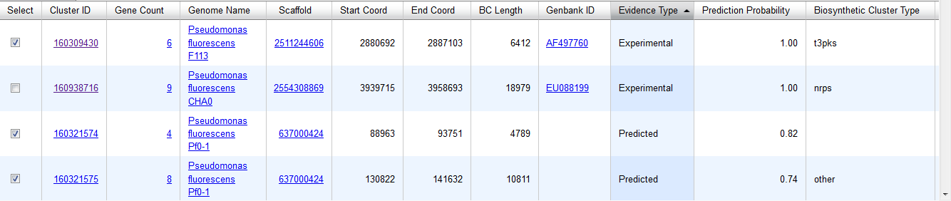
Case study: Exploring the clusters
Are there any experimentally verified clusters?
Do they produce any known SMs?
What are BC cluster types?

Slide 24
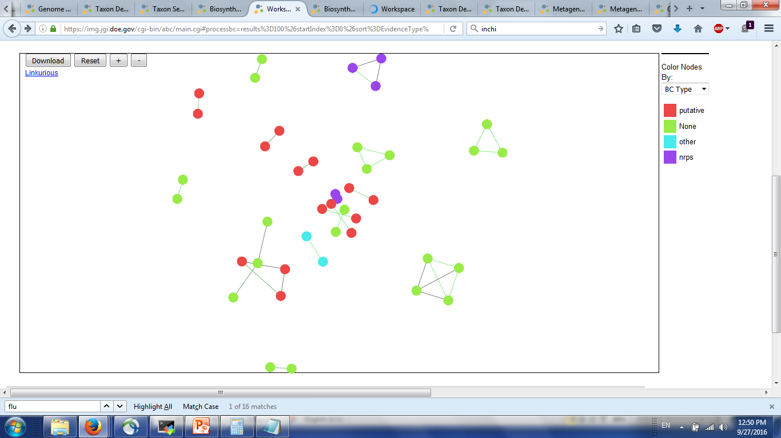
Case Study: Visualizing cluster diversity
Select all BCs in the Cart and click on “Similarity Network” tab, then click on “Plot”.
Alternatively click on “Download Data”, import into Cytoscape

Slide 25
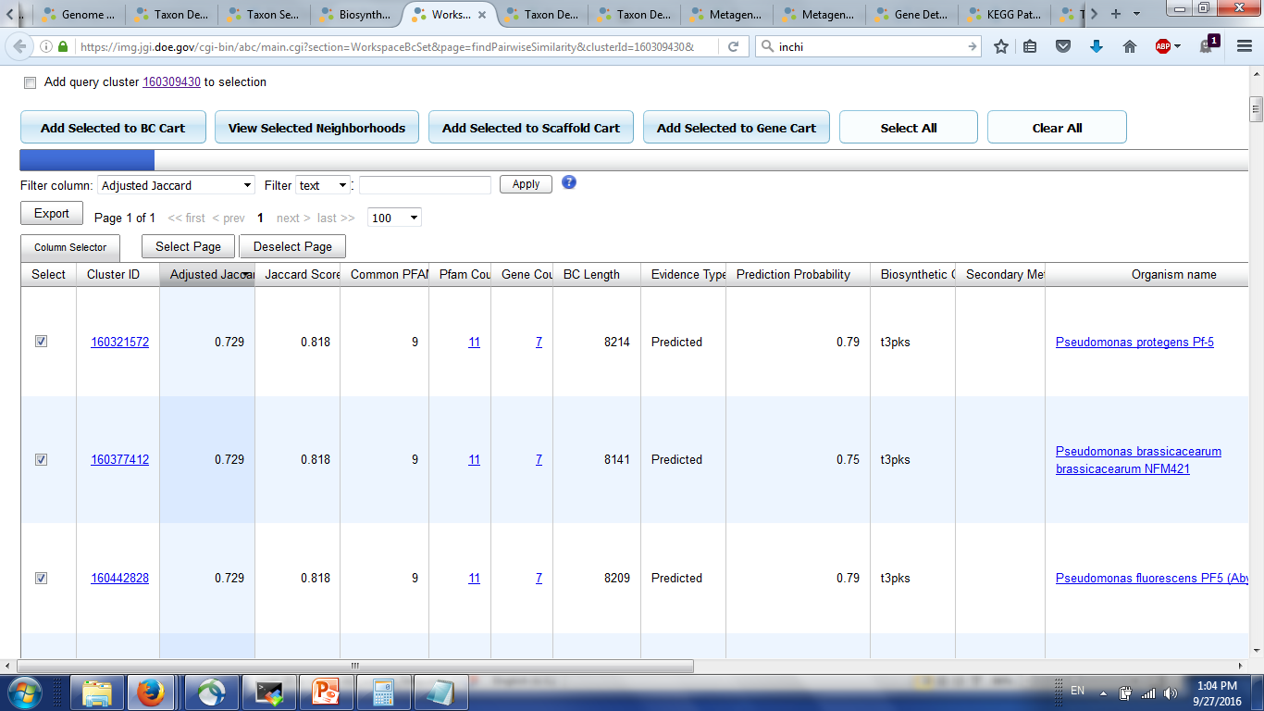
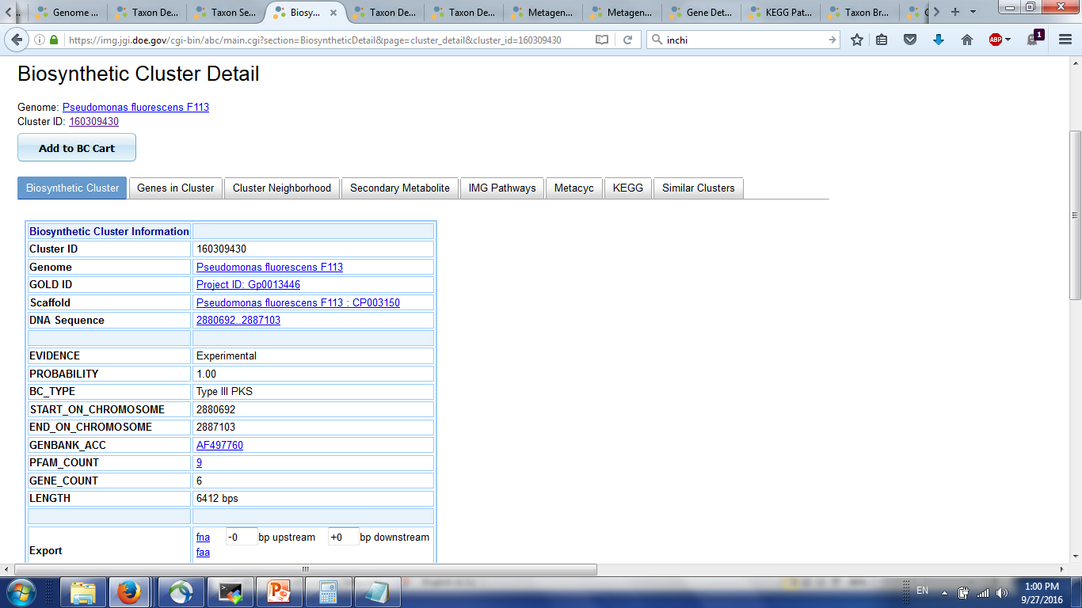
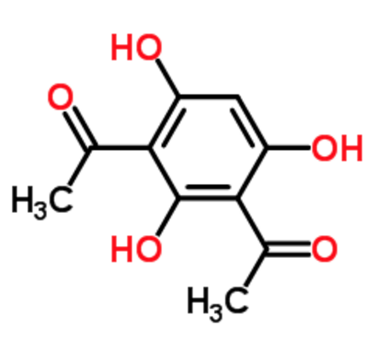
Case Study: Exploring diacetylphloroglucinol clusters
2-4-diacetylphloroglucinol (DAPG)
“… responsible for the antiphytopathogenic and biocontrol properties in…” some Pseudomonas fluorescens
Let’s learn more about this BC.

Slide 26
Case study: what do these numbers mean?
Jaccard Similarity Index
BC1
BC2
(5)
Score =
= 0.71
(7)
Adjusted Score = 0.36 *Jaccard Index + 0.64 * domain duplication index
Lin, Kui, Lei Zhu, and Da-Yong Zhang. "An initial strategy for comparing proteins at the domain architecture level." Bioinformatics 22.17 (2006): 2081-2086.
Cimermancic, Peter, et al. "Insights into secondary metabolism from a global analysis of prokaryotic biosynthetic gene clusters." Cell 158.2 (2014): 412-421.

Slide 27
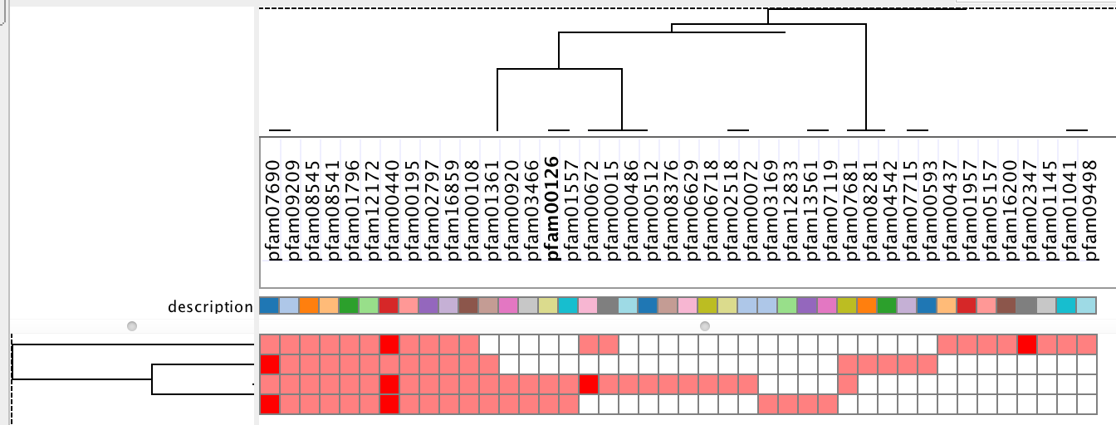
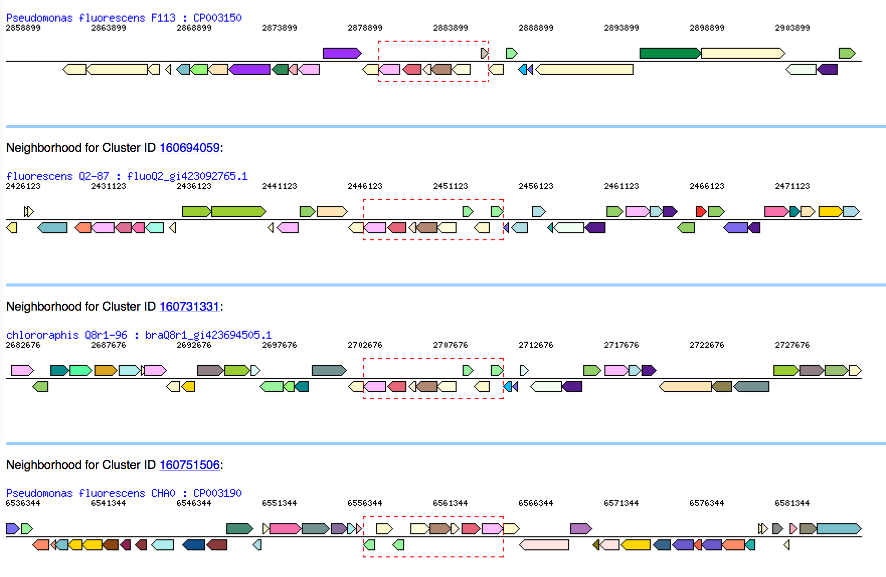
Case Study: do these clusters look like DAPG?
Add clusters with high Jaccard similarity to the BC Cart
Click on “Neighborhoods” tab to visualize conservation of Pfams and gene order
Click on «Function HeatMap» to visualize conservation of Pfams

Slide 28
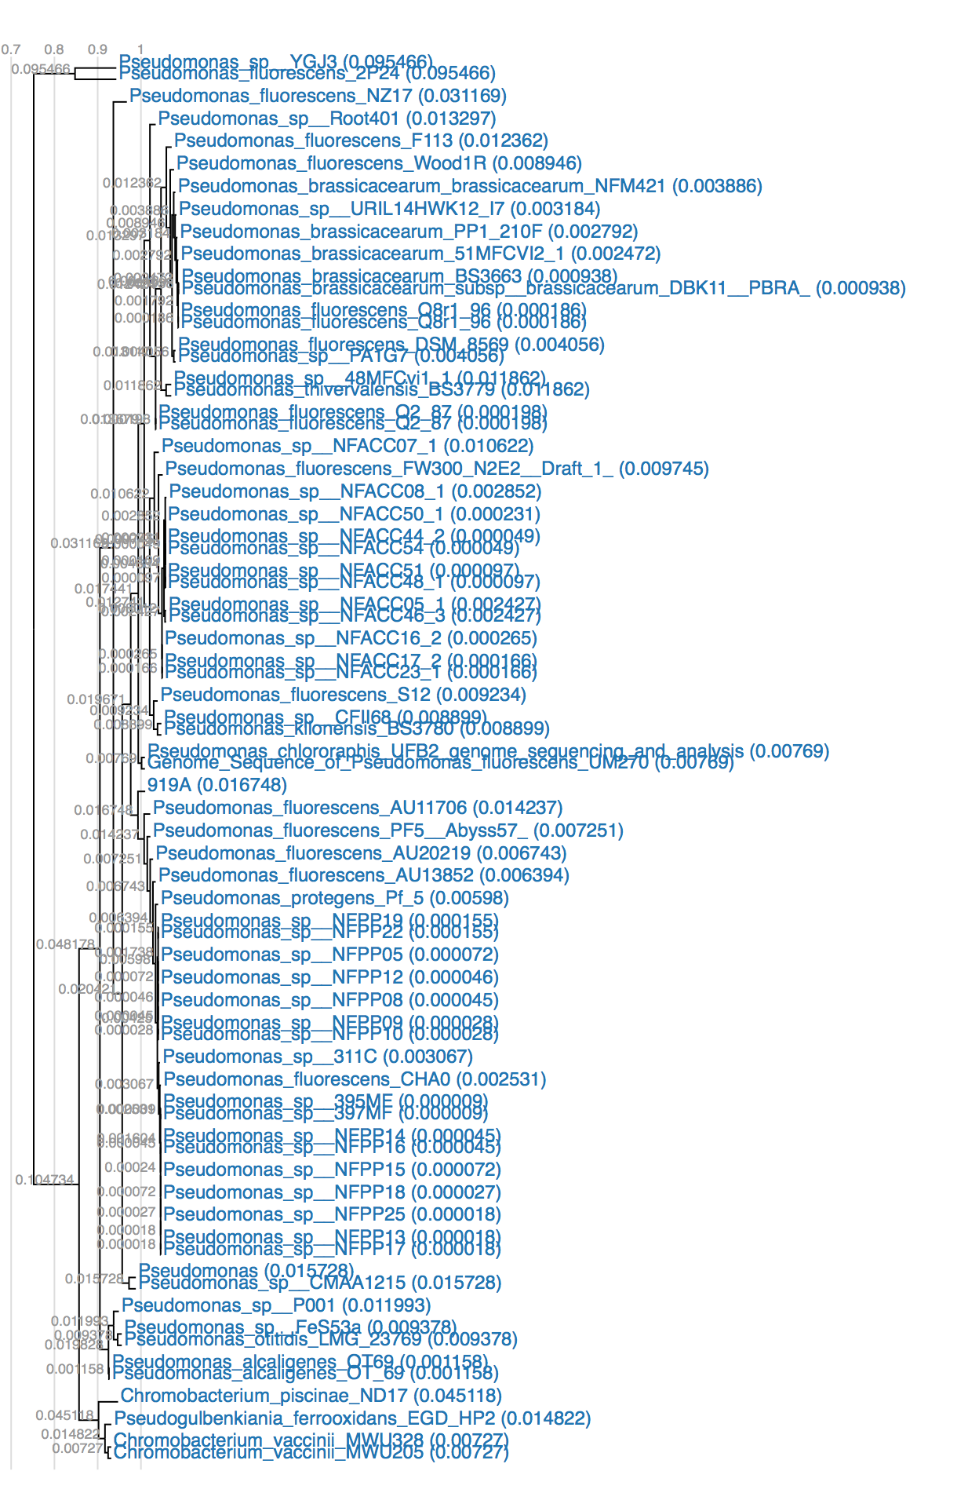
Case Study
13 potential DAPG BCs found.
Where are they coming from?
Add Genomes to Genome Cart and add Ecosystem Column
41 Host-associated
5 Environmental
Create a phylogenetic tree using the Genome Clustering function in the Compare Genomes tab.
Almost all are in Pseudomonas species, except for the betaproteobacterium Pseudogulbenkiania ferrooxidans EGD-HP2 (fresh water)

Slide 29
End of Case Study

Slide 30
Use Case – hands on exercises
Is this gene in a BC?
How many BCs does this genome have?
What BCs encode a compound that is similar to a specific known compound?
What is the phylogenetic distribution of bacteria containing a specific BC type?
How can I find high confidence BCs containing a specific enzymatic activity and might encode for a large SM?

Slide 31
Use Cases
Is this gene in a BC?
How many BCs does this genome have?
What BCs encode a compound that is similar to a specific known compound?
What is the phylogenetic distribution of bacteria containing a specific BC type?
How can I find high confidence BCs containing a specific enzymatic activity and might encode for a large SM?
Is gene with gene ID 640640151 in a BC?

Slide 32
Use Cases
Is this gene in a BC?
How many BCs does this genome have?
What BCs encode a compound that is similar to a specific known compound?
What is the phylogenetic distribution of bacteria containing a specific BC type?
How can I find high confidence BCs containing a specific enzymatic activity and might encode for a large SM?
How many BCs does Rhodobacterales sp. HTCC2150 (IMG ID 640612203) have?
https://img.jgi.doe.gov/cgi-bin/w/main.cgi?section=TaxonDetail&page=taxonDetail&taxon_oid=640612203

Slide 33
Use Cases
Is this gene in a BC?
How many BCs does this genome have?
What BCs encode a compound that is similar to a specific known compound?
What is the phylogenetic distribution of bacteria containing a specific BC type?
How can I find high confidence BCs containing a specific enzymatic activity and might encode for a large SM?
What BCs encode a compound that is similar to Azithromycin?
Azithromycin is a semi-synthetic drug that has been used in the treatment of Mycobacterium avium intracellulare infections, toxoplasmosis, and cryptosporidiosis.

Slide 34
Use Cases
Is this gene in a BC?
How many BCs does this genome have?
What BCs encode a compound that is similar to a specific known compound?
What is the phylogenetic distribution of bacteria containing a specific BC type?
How can I find high confidence BCs containing a specific enzymatic activity and might encode for a large SM?
Homoserine Lactone is an SM often used for quorum sensing.
Which phylogenetic order has the most Homoserine Lactone producing bacteria?

Slide 35
Use Cases
Is this gene in a BC?
How many BCs does this genome have?
What BCs encode a compound that is similar to a specific known compound?
What is the phylogenetic distribution of bacteria containing a specific BC type?
How can I find high confidence BCs containing a specific enzymatic activity and might encode for a large SM?
Transposases are often associated with BCs due to their mobile nature.
Which high confidence BCs contain transposases, are classified as Type I Polyketide Synthase clusters and might encode for a large SM.

Slide 36
Use Cases
Is this gene in a BC?
How many BCs does this genome have?
What BCs encode a compound that is similar to a specific known compound?
What is the phylogenetic distribution of bacteria containing a specific BC type?
How can I find high confidence BCs containing a specific enzymatic activity and might encode for a large SM?
Is gene with gene ID 640640151 in a BC?

Slide 37
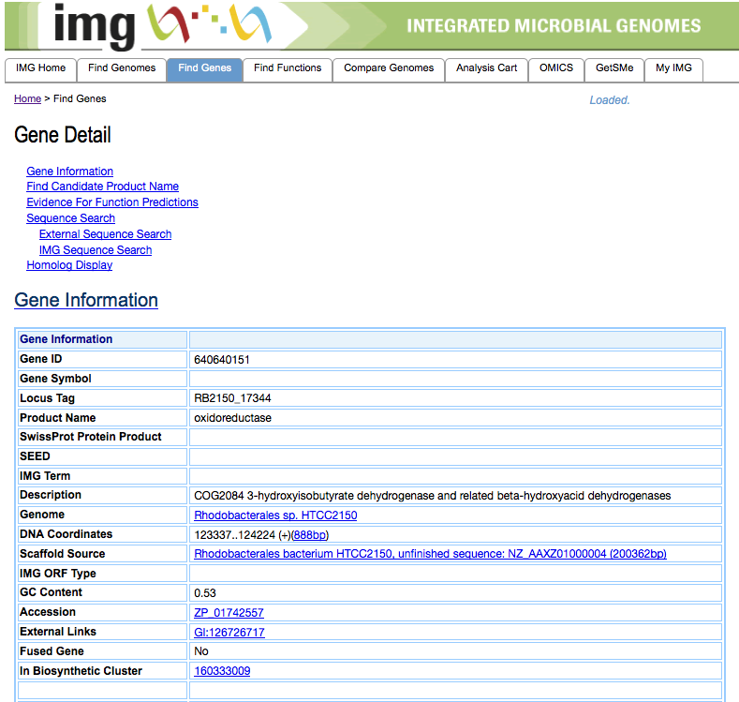
Is gene with gene ID 640640151 in a BC?
https://img.jgi.doe.gov/cgi-bin/w/main.cgi?section=GeneDetail&page=geneDetail&gene_oid=640640151

Slide 38
Use Cases
Is this gene in a BC?
How many BCs does this genome have?
What BCs encode a compound that is similar to a specific known compound?
What is the phylogenetic distribution of bacteria containing a specific BC type?
How can I find high confidence BCs containing a specific enzymatic activity and might encode for a large SM?
How many BCs does Rhodobacterales sp. HTCC2150 (IMG ID 640612203) have?
https://img.jgi.doe.gov/cgi-bin/w/main.cgi?section=TaxonDetail&page=taxonDetail&taxon_oid=640612203

Slide 39
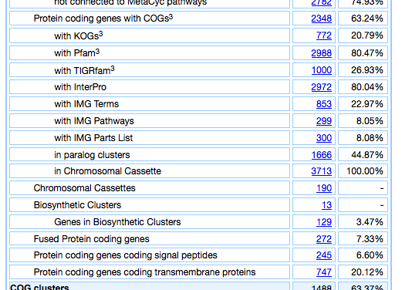
How many BCs does Rhodobacterales sp. HTCC2150 have?
Go to Genome detail page
Scroll down to Statistics Section
If this genome has BCs annotated, it will have a “Biosynthetic Clusters” row with the number of total BCs.

Slide 40
Use Cases
Is this gene in a BC?
How many BCs does this genome have?
What BCs encode a compound that is similar to a specific known compound?
What is the phylogenetic distribution of bacteria containing a specific BC type?
How can I find high confidence BCs containing a specific enzymatic activity and might encode for a large SM?
What BCs encode a compound that is similar to Azithromycin?
Azithromycin is a semi-synthetic drug that has been used in the treatment of Mycobacterium avium intracellulare infections, toxoplasmosis, and cryptosporidiosis.

Slide 41
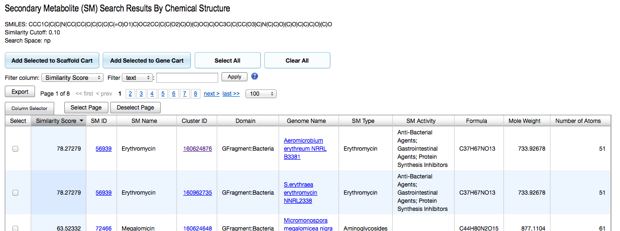
What BCs encode a compound that is similar to Azithromycin?
Search SMs for “Azithromycin” -> FAIL! It’s semi-synthetic
Find SMILES for azithromycin (use google, pubchem compound, etc)
Use Search by Structure Function -> SUCCESS!

Slide 42
Use Cases
Is this gene in a BC?
How many BCs does this genome have?
What BCs encode a compound that is similar to a specific known compound?
What is the phylogenetic distribution of bacteria containing a specific BC type?
How can I find high confidence BCs containing a specific enzymatic activity and might encode for a large SM?
Homoserine Lactone is an SM often used for quorum sensing.
Which phylogenetic order has the most Homoserine Lactone producing bacteria?

Slide 43
Which phylogenetic order has the most Homoserine Lactone producing bacteria?
Couple of ways to answer question. Fastest is:
Go to BC Statistics page
Browse by BC_TYPE
Click on “hserlactone”
Add scaffolds to Scaffold cart
In scaffold cart, add genomes to Genome cart
In genome cart, “Group Genome Cart by Phyla”
In Genome Cart Phylum List, select “Group Genome Cart by”->“Order”

Slide 44
Use Cases
Is this gene in a BC?
How many BCs does this genome have?
What BCs encode a compound that is similar to a specific known compound?
What is the phylogenetic distribution of bacteria containing a specific BC type?
How can I find high confidence BCs containing a specific enzymatic activity and might encode for a large SM?
Transposases are often associated with BCs due to their mobile nature.
Which high confidence BCs contain transposases, are classified as Type I Polyketide Synthase clusters and might encode for a large SM.

Slide 45
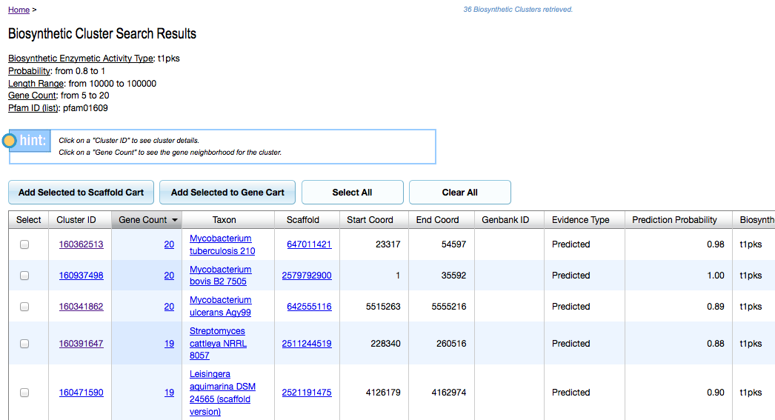
Find interesting BCs that have transposases
Find PFAM corresponding to transposases -> pf01609
Search for BCs containing this pf01609, have BC type type “t1pks”, are between 10,000 and 100,000 bases long, have 5-20 genes, and a probability higher than 0.8.

